Slide 1

Environmetric
Project Supervisor
Dr Shahnewaz Siddique
Nuren Shams F M A Faisal Sakib
Abrar Fahim Md. Jaber Hossain

Slide 2
PROBLEM STATEMENT
CURRENT SITUATION:
Dhaka air pollution today world's worst – Dhaka Tribune, February 2019
Dhaka ranks worst in Air Quality Index – The Independent, March 2019
Global survey says Bangladesh has most polluted air; Dhaka 2nd most polluted capital city – The Daily Star, March 2019
Air pollution killed 1.23 lakh in 2017 – The Daily Star, April 2019
SOURCES OF AIR POLLUTION:
Power plants & metal industry – source of metal oxide emissions
Tannery, plastics & petroleum Industry – major source of volatile organic compound emission
Cement, construction & demolition industry – primary source of particulate matter emission
Fossil fuel powered industries & unregulated internal combustion engine powered vehicles – emit carbon-dioxide
EFFECTS OF AIR POLLUTION:
70 lakh suffer from asthma in Bangladesh – Dhaka Tribune, May 2014
Respiratory diseases skyrocketing in Bangladesh – The Daily Star, April 2018
2.34 lakh deaths in Bangladesh in 2015 linked to environmental pollution, of which 80,000 in urban areas – The Daily Star, September 2018

Slide 3
OBJECTIVE
To deliver a standalone pipeline designed to collect, process, archive, analyze and visualize atmospheric pollution data.

Slide 4

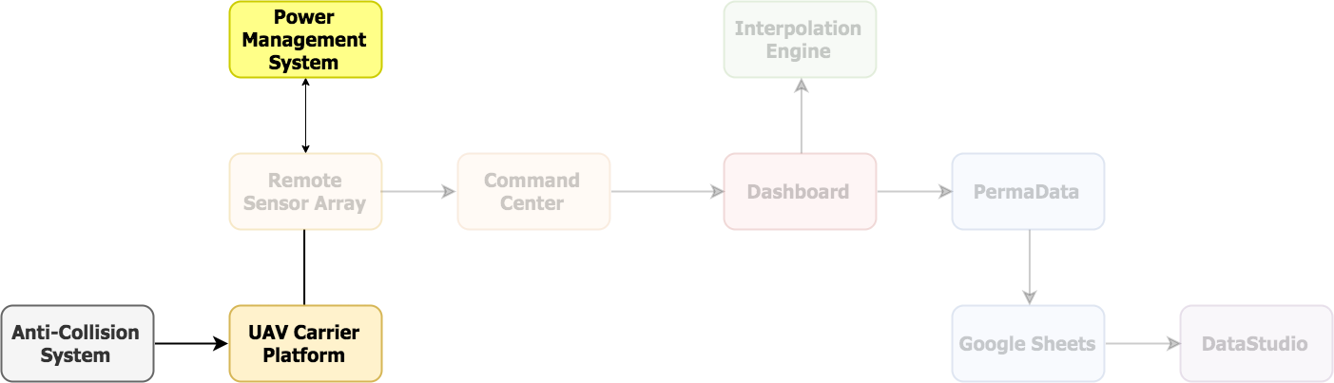
CORE ARCHITECTURE
Anti-Collision System is a closed loop feedback controller that aids autonomous UAV navigation through preemptive collision detection.
Unmanned Aerial Vehicle Carrier Platform enables the Remote Sensor Array to collect data in a spatial paradigm.
Power Management System is a polling architecture based closed loop feedback controller to monitor the voltage level of the Remote Sensor Array’s power source.

Slide 5
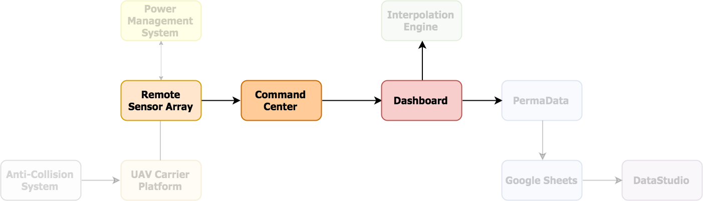
CORE ARCHITECTURE
Remote Sensor Array is a suite of sensors that provides data collection capabilities to the EnvironMetric system.
Command Center is a bi-directional interpreted command-based communication interface that connects the EnvironMetric’s frontend(Dashboard) and backend( Remote Sensor Array).
Dashboard is the nerve center of the EnvironMetric system which uses an simple GUI to send command to the system, receive data from the Remote Sensor Array and visualize the data.

Slide 6
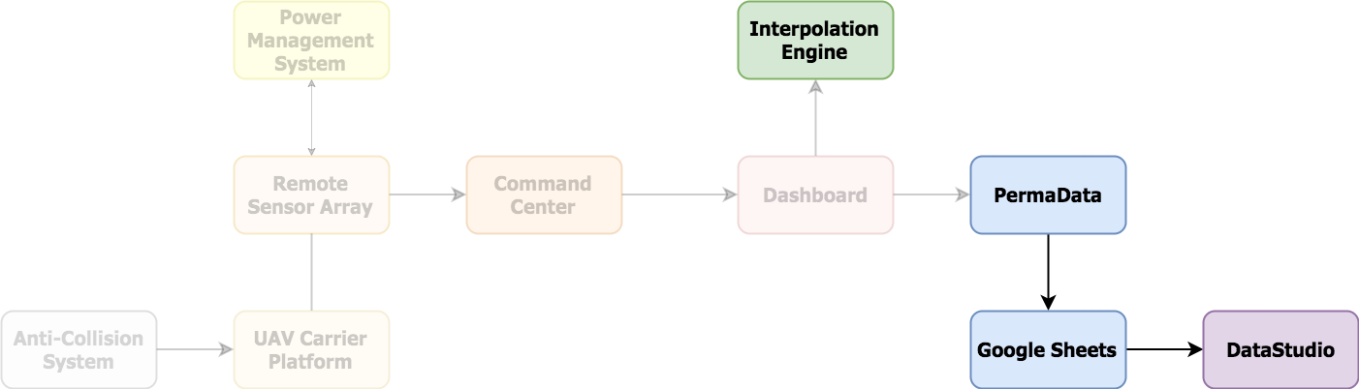
CORE ARCHITECTURE
PermaData, short for Permanent Data Storage, is a tensor based data archive interface currently implemented by using Google’s BigQuery Service.
Interpolation Engine is a universal function approximator implemented using a fully-connected feed-forward artificial neural network to convert discreet data points to continuous data.
DataStudio is a macro level data visualisation tool currently implemented by using Google’s DataStudio Service

Slide 7
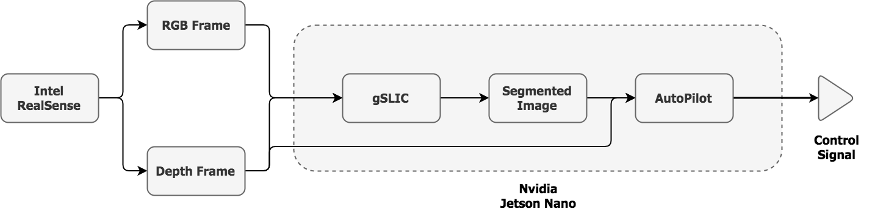
1. Anti-Collision System
Uses the Intel D435i stereoscopic camera.
Uses a CUDA accelerated version of the SLIC algorithm to segment & identify objects.
The segmented image is used as a mask to isolate objects of interest.
A combination of perspective geometry and threshold-based filtering is used to predict possible collisions.
Control signals are transmitted to the UAV’s flight controller through its telemetry channel

Slide 8
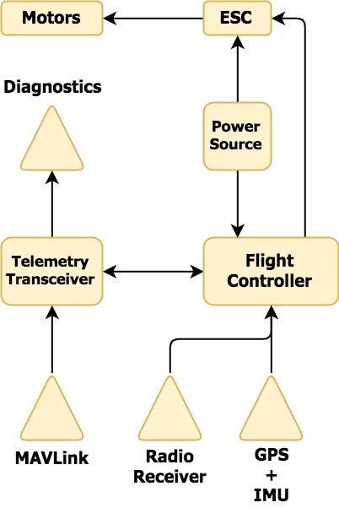
2. UAV Carrier Platform
Allows RSA to collect data in a spatial paradigm.
Uses a 1000 class hexacopter frame as its chassis.
Uses six 5008 340KV brushless motors to provide thrust & a 6S1P 16Ah LiPo battery to power them through six 40A ESC.
Uses a Raspberry Pi 3B+ with a Navio2 HAT running the ArduPilot stack as its flight controller.
Autonomous & Telemetry communication uses the MAVLink protocol.
A 2.4GHz 16-channel radio system is used for manual control.

Slide 9
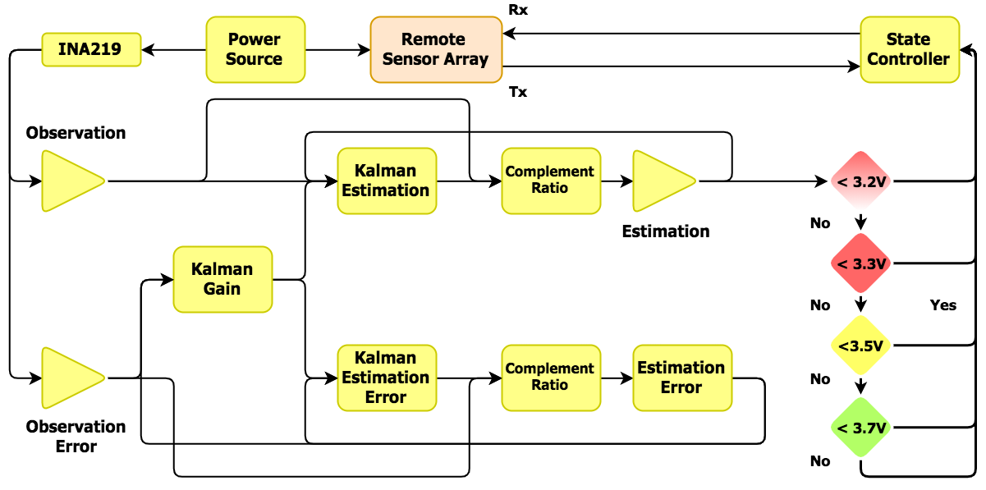
3. Power Management System
Probes the INA219 at a frequency of ~1kHz to measure the voltage.
The noise in the measurement interferes with the comparison operations of ATMega4809 microcontroller.
A combination of Linear Kalman Filter & Complementary Filter is used attenuate the noise.

Slide 10
3. Power Management System
Communicates the state of the RSA & instructions through a pair of digital Rx/Tx lines.
The PMS also models a finite-state machine with 4 distinct states - Normal mode, Warning mode, Critical mode & Hibernation mode

Slide 11
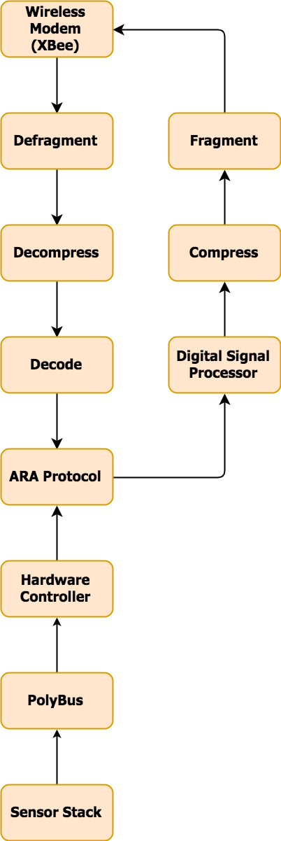
4. Remote Sensor Array
It can operate in both a temporal and spatial paradigm (Using UAV CP).
It is based on the single-producer-multi-consumer architecture.
Uses the Asynchronous Remote Acquisition protocol which allows it to serve multiple clients concurrently.
Uses dedicated radio communication system established by a mesh network composed of XBee modems.

Slide 12
4. Remote Sensor Array
Uses AHRS algorithm to accurately keep track of its position.
Uses a Raspberry Pi 4B 4GB model as its compute platform. It connects with various types of sensors via PolyBus interface.
PolyBus interface allows a single master controller to interface with multiple instances of the same sensor.
This helps to increase data refresh rates & reduce measurement noise

Slide 13
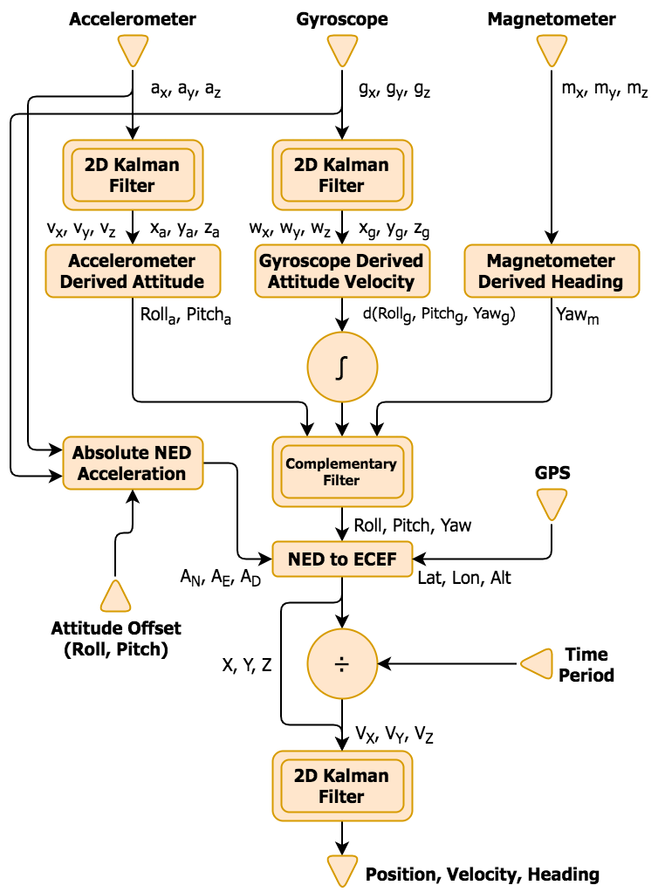
4.a. Attitude Heading Reference System
Provides the proper positioning of the UAV by using raw accelerometer, gyroscope & magnetometer data.
To remove noise from the raw accelerometer & gyroscope data 2D Linear Kalman filter is used.
From raw accelerometer & gyroscope data absolute NED acceleration is calculated.
Using the absolute NED acceleration along with accelerometer, gyroscope & magnetometer derived attitude and heading the location of UAV is calculated in Earth Centered Earth Fixed (ECEF) coordinate.

Slide 14
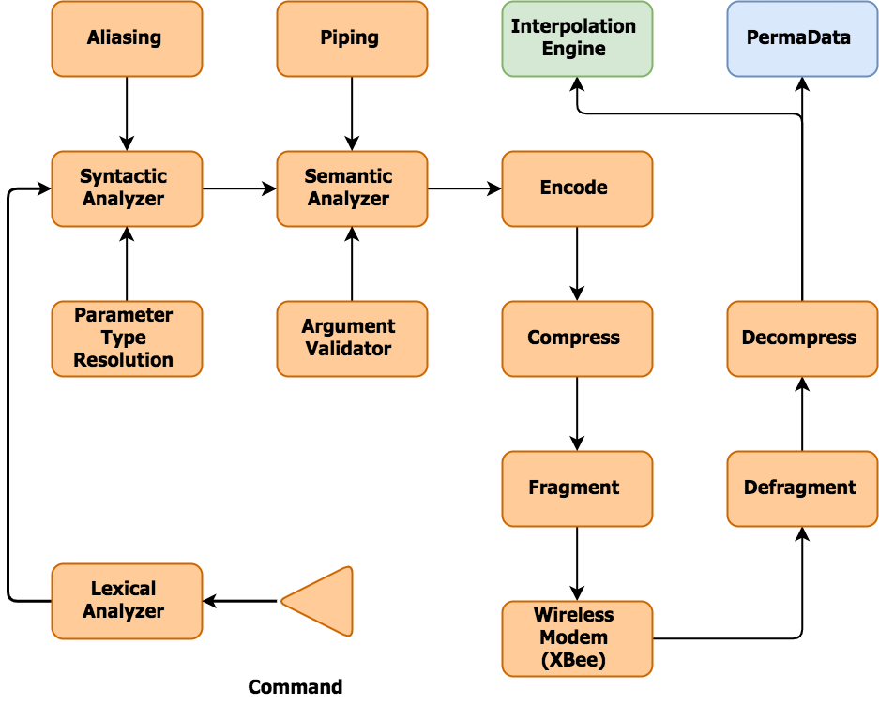
5. Command Center
Connects the EnvironMetric’s front end (Dashboard) with its backend (RSA).
It abstracts the entire mechanism of collecting, filtering, processing, packaging and transmitting the requested piece of data.
The Command language has a close resemblance with UNIX bash.
It is a standalone API-like module, complete with its own interpreter.
It also provides advance features to technical operators to configure, debug, diagnose & benchmark the RSA.

Slide 15
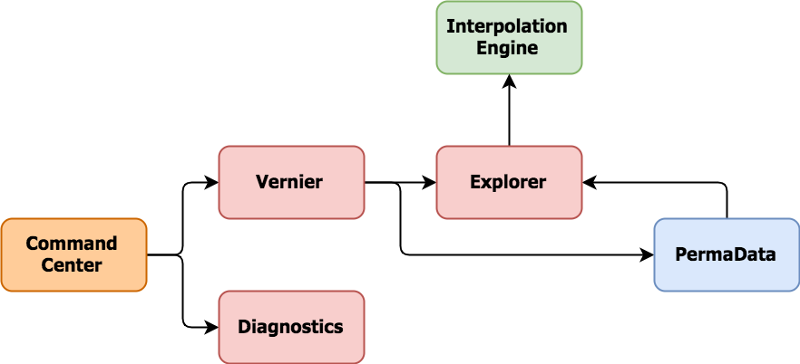
6. DashBoard
The Dashboard is another layer of abstraction on top of the command centre.
The Dashboard GUI has three key components for data acquisition and visualization.
The Vernier uses the underlying Command Center API to provide a simple to use GUI to collect environmental data and pushes them to PermaData for archival.

Slide 16
6. DashBoard
The Explorer pulls data from PermaData archival for visualization through heatmaps.
TheDiagnostics is used to receive raw data from the sensors in a text format.
Considering the non-technical people’s usage this easy to use GUI based platform was built.

Slide 17
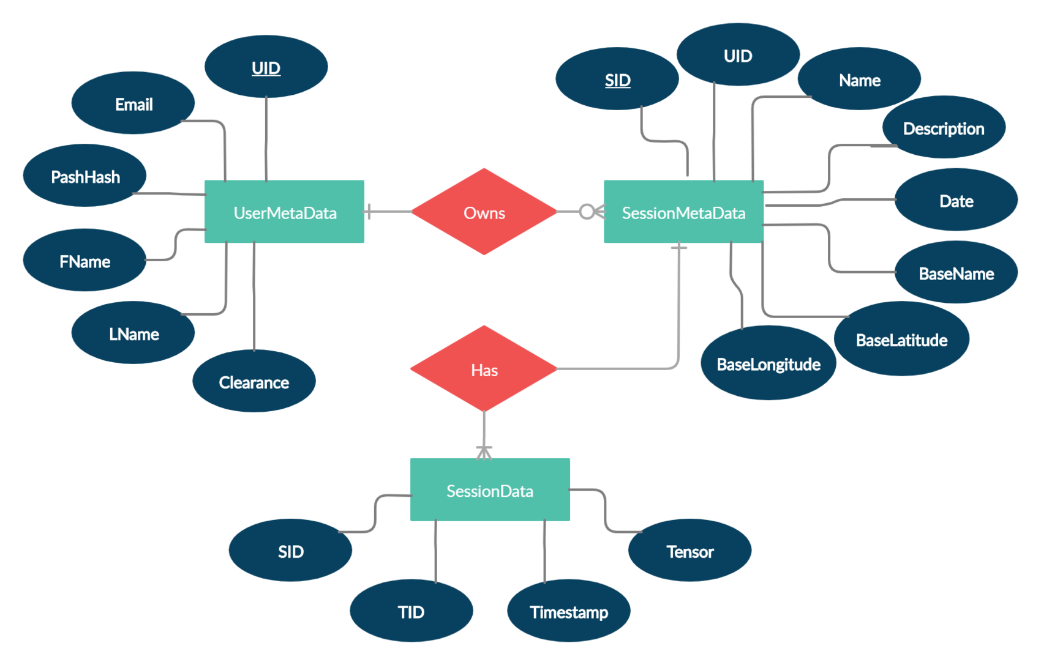
7. PermaData
PermaData, short for Permanent Data Storage, is a tensor-based data archive interface currently implemented by using Google’s BigQuery Service.
A key-value tensor-based data storage schema was chosen because of the flexibility it offers in-terms adding/removing measurement metrics during runtime, albeit at the cost of query efficiency.
Figure: Entity Relationship Diagram of PermaData Database.

Slide 18
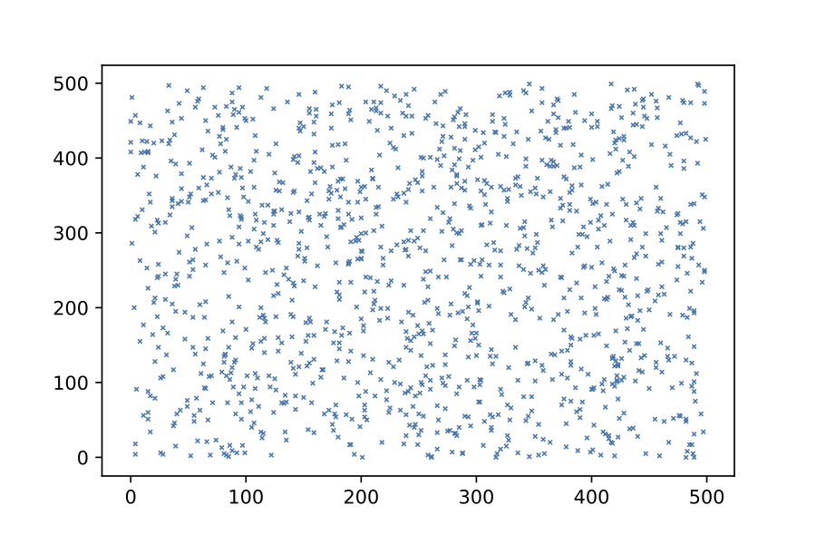
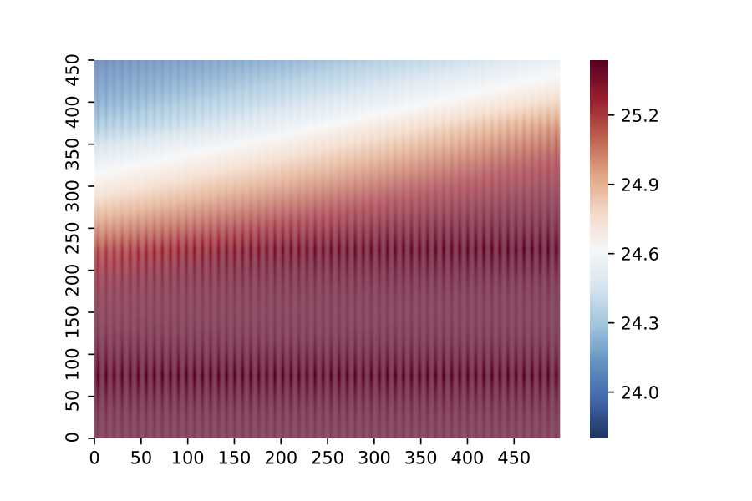
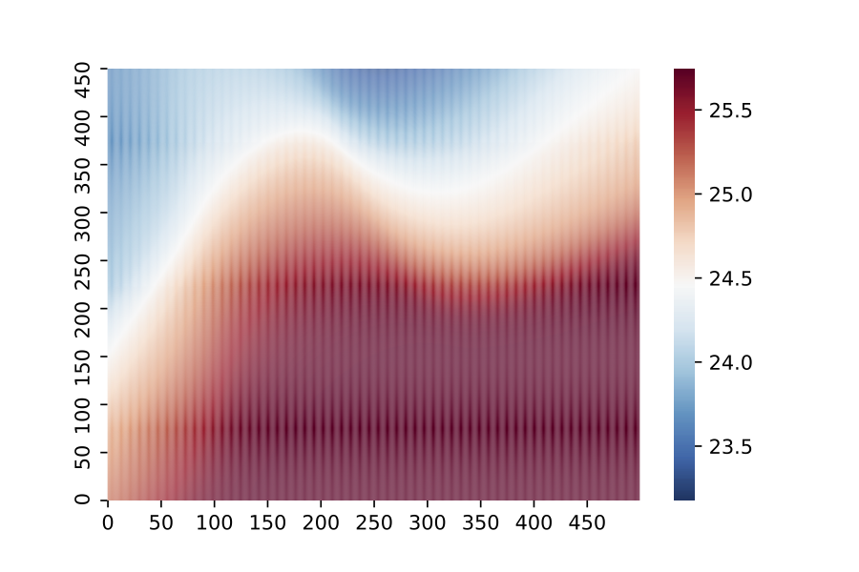
8. Interpolation Engine
It is a universal function approximator that’s implemented using a fully-connected feed-forward artificial neural network (FC-FF-ANN) to convert discreet data points to continuous data.
Heatmaps require continuous data, but due to the limitations in the sensors’ data acquisition capabilities, they are only able to provide discrete data points.
Figure 1: Scatterplot of discrete sensor data
Figure 2: Heatmap of continuous data (intermediate stage)
Figure 3: Heatmap of continuous data (final stage)

Slide 19
8. Interpolation Engine
The interpolation engine takes these discrete data points, splits them into an 80/20 ratio.
The bigger split is used to train a FC-FF-ANN model which behaves like a universal function approximator.
The smaller split is used to determine the correct model complexity to achieve a proper bias-variance balance.
Figure 1: Scatterplot of discrete sensor data
Figure 2: Heatmap of continuous data (intermediate stage)
Figure 3: Heatmap of continuous data (final stage)

Slide 20
9.DataStudio

Slide 21
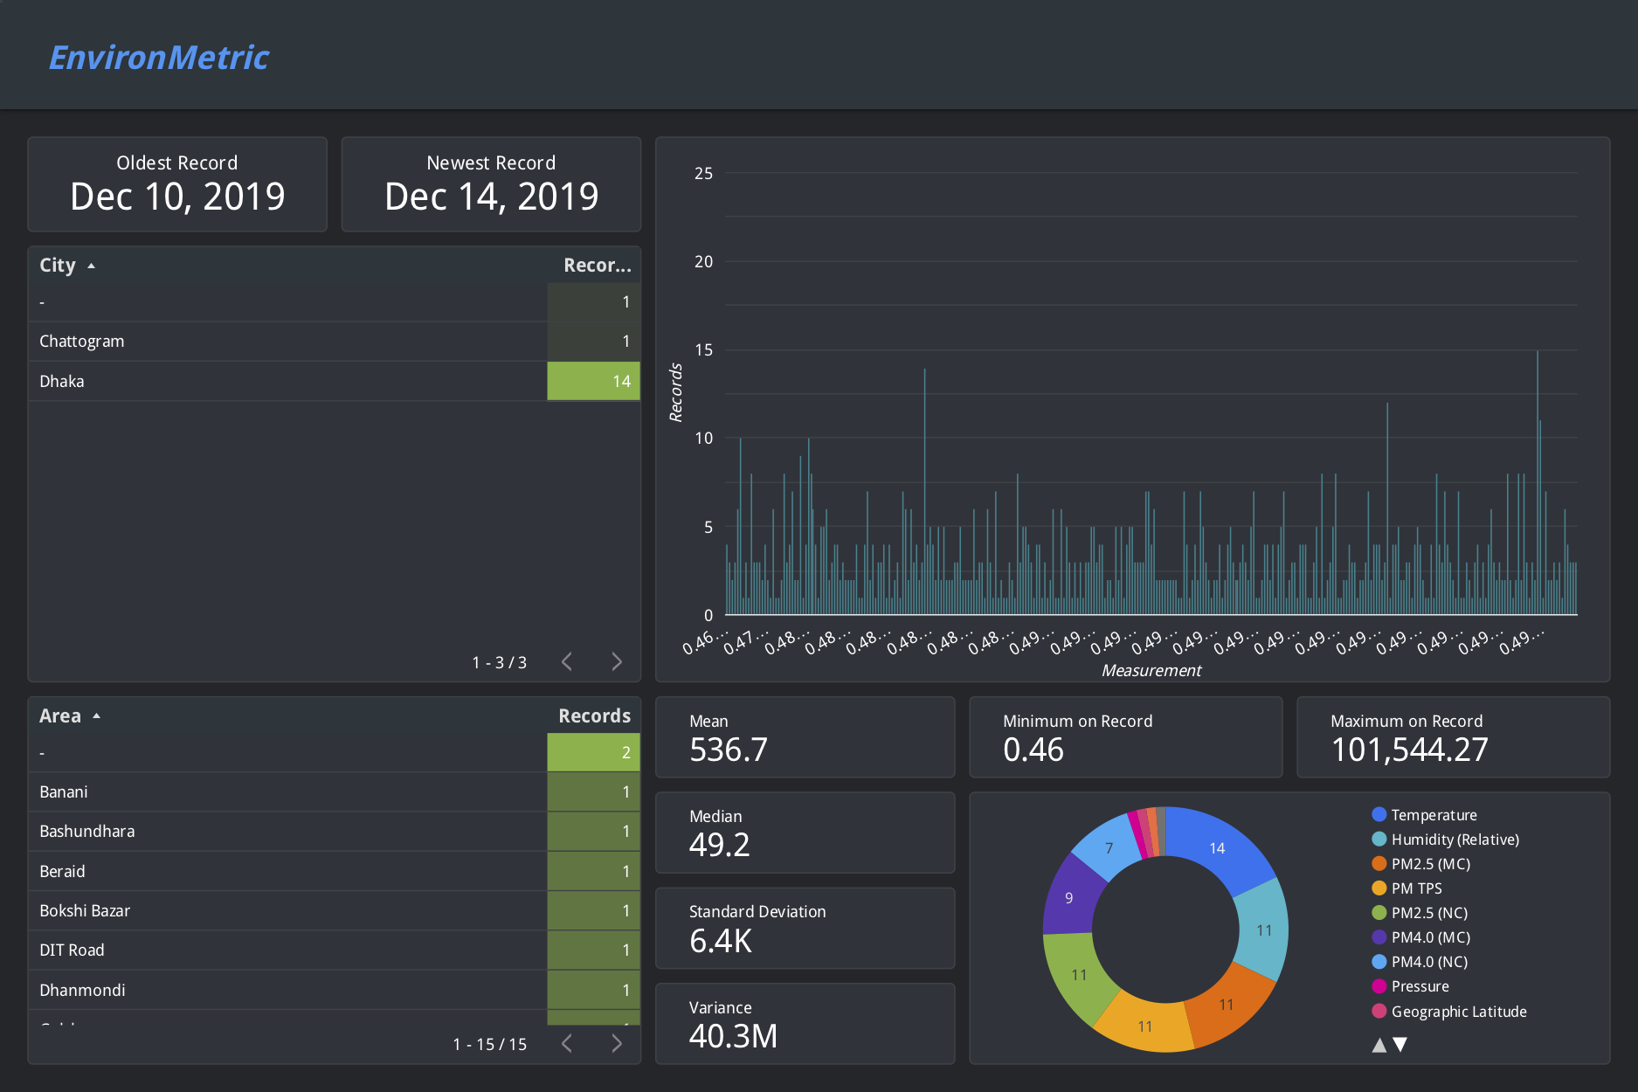

Slide 22
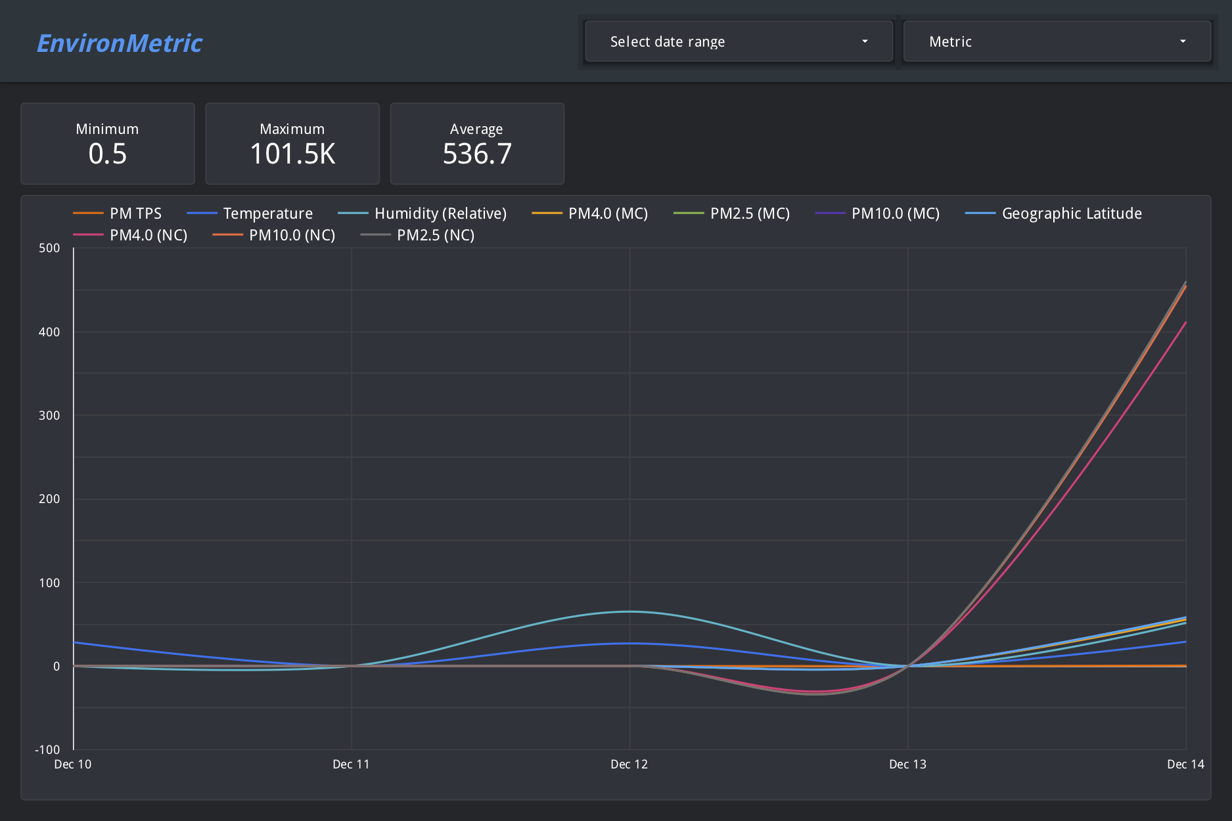

Slide 23
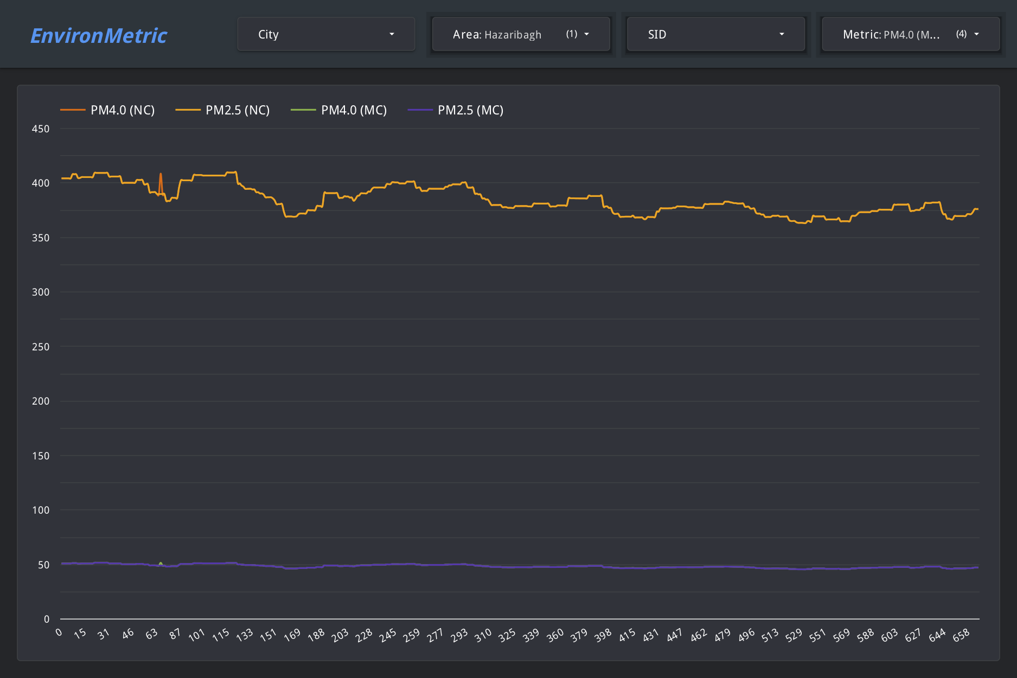

Slide 24
THANK YOU

